Slide 1


Air quality forecasting
(Co2 Emissions)
P-81 GROUP 4
Gurrapu Ranadeep
G M Prasanna Kalyan
Vishwas Suryawanshi
Aishwarya Chavan
Tushar Patil
Mentor- Parth

Slide 2

BUSINESS PROBLEM
Carbon dioxide (CO₂) emissions are the primary driver of global climate change. It is widely recognised that to avoid the worst impacts of climate change, the world needs to urgently reduce emissions.
Many industrial processes emit CO₂ through fossil fuel consumption. Several processes also produce CO₂ emissions through chemical reactions that do not involve combustion. Many industrial processes also use electricity and therefore indirectly result in CO₂ emissions from electricity generation.
CO₂ is constantly being exchanged among the atmosphere, ocean, and land surface as it is both produced and absorbed by many microorganisms, plants, and animals. Since the Industrial Revolution began around 1750, human activities have contributed substantially to climate change by adding CO₂ and other heat-trapping gases to the atmosphere.

Slide 3
BUSINESS OBJECTIVE
To forecast Co2 levels for an organization so that the
organization can follow government norms with respect to Co2 emission levels.

Slide 4
PROJECT ARCHITECTURE
DD
BUSINESS OBJECTIVE
DATA COLLECTION
EXPLORATORY DATA ANALYSIS
DATA PREPROCESSING
MODEL SELECTION
MODEL EVALUATION
MODEL DEPLOYMENT

Slide 5
Exploratory Data Analysis (EDA)

Slide 6
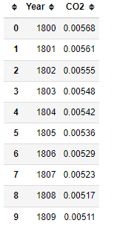
DATASET DETAILS
ROWS- 215
COLUMNS- 2
NO NULL VALUES
NO MISSING VALUES
NO DUPLICATE VALUES
NO OUTLIER
DATA IS RIGHT SKEWED
COLUMNS ‘Year' AND 'CO2' HAVE A VERY GOOD CORRELATION.

Slide 7
DATA VISUALIZATION

Slide 8
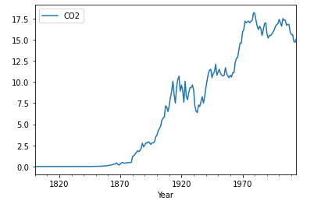
Line Plot
Line plot tracking emission of CO2 over periods of years

Slide 9
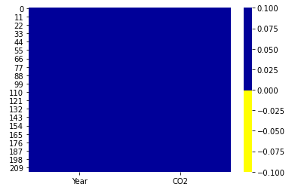
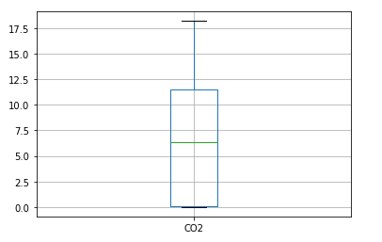
HEATMAP
Heat Map shows No missing values are present in the dataset
BOXPLOT
Boxplot shows No outliers are present in the dataset

Slide 10
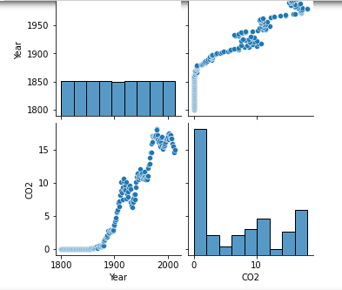
PAIRPLOT
Pair plot showing relationship between Year and CO2 columns

Slide 11
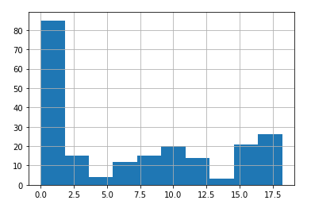
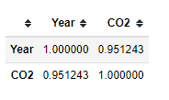
HISTOGRAM
Histogram showing that Data is right skewed
CORRELATION MATRIX
Correlation Matrix shows Columns Year and CO2 have a very good correlation

Slide 12
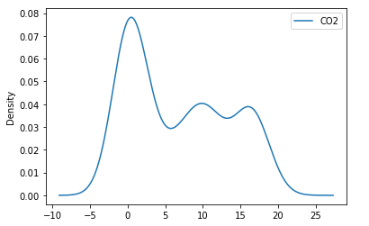
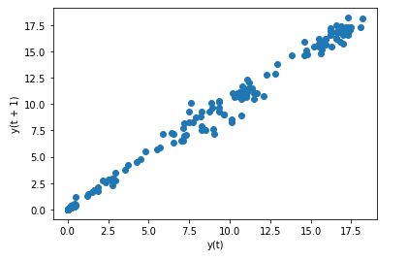
DENSITY PLOT
Density Plot shows Distribution of data
SCATTER PLOT
Scatter Plot shows Strong positive linear correlationship between variables

Slide 13
Transforming of Data to Normal Distribution
SQUARE-ROOT TRANSFORMATION
LOG TRANSFORMATION
RECIPROCAL TRANSFORMATION
EXPONENTIAL TRANSFORMATION

Slide 14
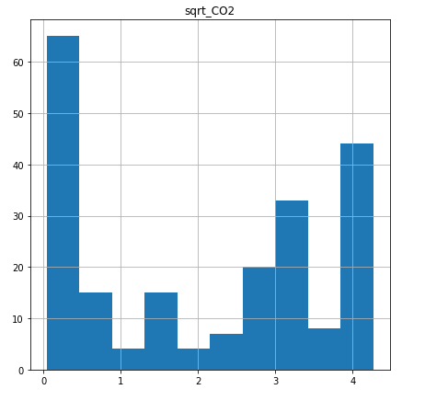
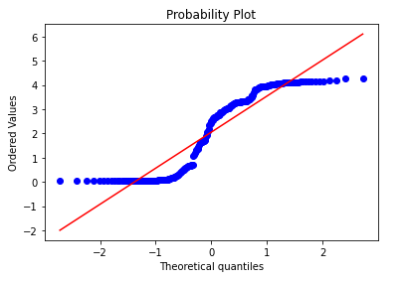
SQUARE-ROOT TRANSFORMATION
Histogram(Skewed)
Probability Plot
(not normally distributed)
After applying Square -root transformation ,we have found that the data is not normally distributed.

Slide 15
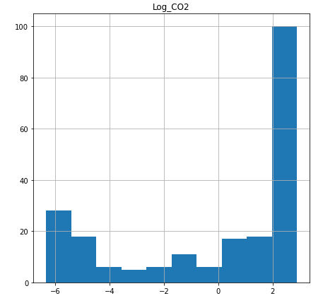
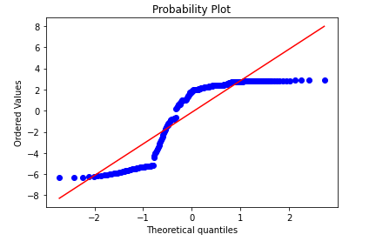
LOG TRANSFORMATION
Histogram(Skewed)
Probability Plot
(not normally distributed)
After applying Log transformation we have found that the data is not normally distributed.

Slide 16
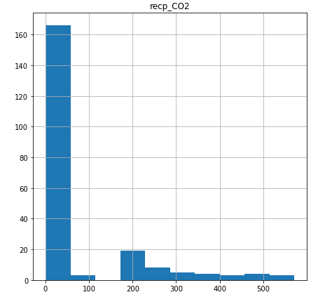
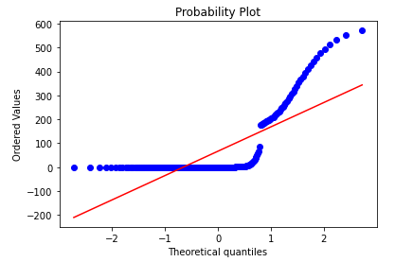
RECIPROCAL TRANSFORMATION
Histogram(Skewed)
Probability Plot
(not normally distributed)
After applying Reciprocal transformation we have found that the data is not normally distributed.

Slide 17
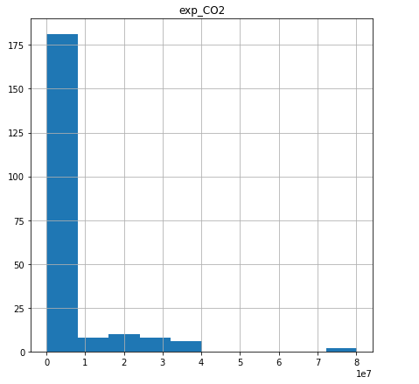
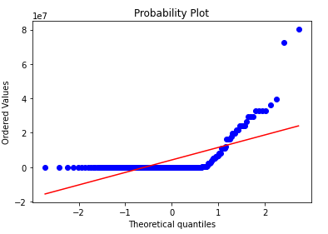
EXPONENTIAL TRANSFORMATION
Histogram(Skewed)
Probability Plot
(not normally distributed)
After applying Exponential transformation we have found that the data is not normally distributed.

Slide 18
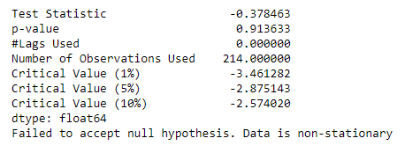
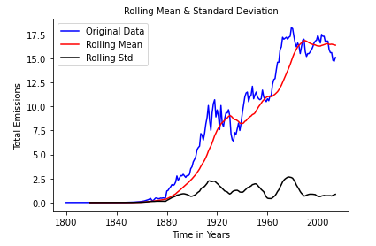
STATIONARITY CHECK
Test stationarity by using Dickey Fuller’s Test
After applying Dickey Fuller’s Test to the data ,we have found that the data is non-stationary.

Slide 19
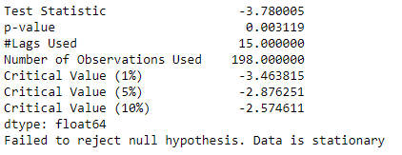
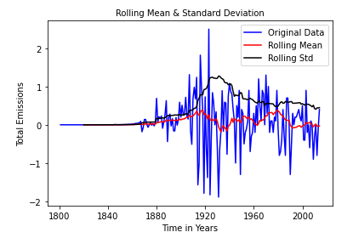
We have applied Differencing to the data, and again we have applied Dickey Fuller’s Test to the data and we have found that the data is stationary.
Differencing has improved the stationarity of the series significantly.

Slide 20
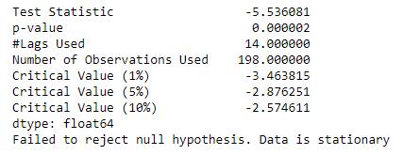
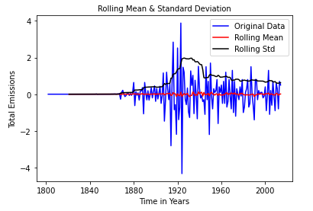
We have applied Seasonal Differencing to the data, and again we have applied Dickey Fuller’s Test to the data and we have found that the data is stationary.
We are considering this seasonal first difference for further analysis because it looks more stationary.

Slide 21
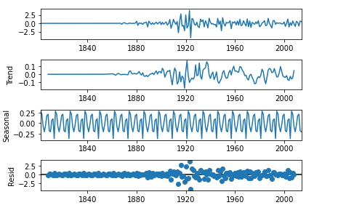
Time Series Decomposition Plot
Level: First plot shows the average value in the series.
Trend: Shows the increasing or decreasing value in the series. Above Plot has a non linear trend.
Seasonality: Shows the repeating short-term cycle in the series.
Resid : Shows the random variation in the series.

Slide 22
ACF Plot and PACF Plot
Autocorrelation Function (ACF): It is a measure of the correlation between the time series with a lagged version of itself.
Partial Autocorrelation Function (PACF): This measures the correlation between the time series with a lagged version of itself but after eliminating the variations already explained by the intervening comparisons.

Slide 23
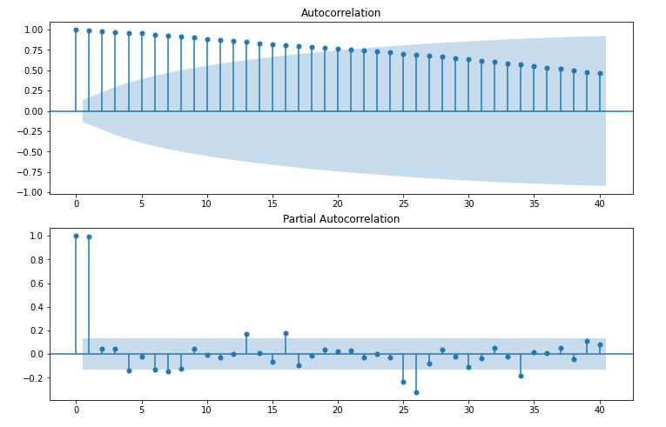
ACF Plot and PACF Plot(Non-Stationary Data)
Gradual Decline in ACF Plot
Sharp dropoff in PACF Plot

Slide 24
Time Series Prediction Models
Forecasting Models(Non-Stationary Data):
Simple Exponential Smoothing
Holt’s Method for Exponential Smoothing
Holts winter exponential smoothing with additive seasonality and additive trend
Holts winter exponential smoothing with multiplicative seasonality and additive trend
Holts winter exponential smoothing with multiplicative seasonality and multiplicative trend
Linear Model
Exponential Model
Quadratic Model
ARIMA Model

Slide 25
DATA PARTITION
DATA(215)
Train(172)
Test(43)

Slide 26
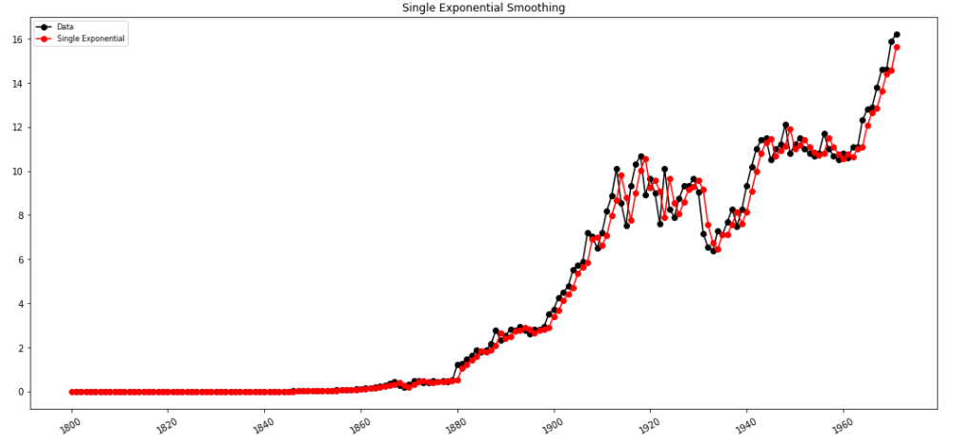
Single Exponential Smoothing
Single Exponential Smoothing works on weighted averages i.e. the average of the previous level and current observation. Largest weights are associated with the recent observations and the smallest weights are associated with the oldest observations.

Slide 27
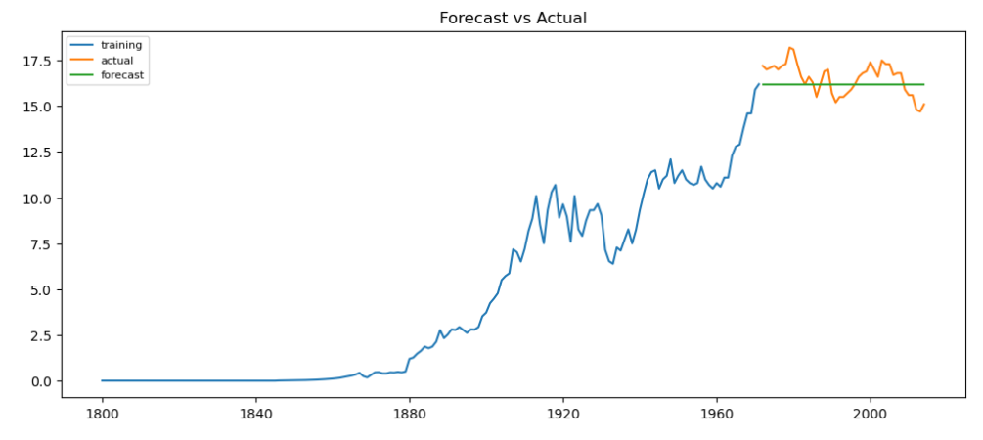
Single Exponential Smoothing
RMSE Value=0.8993
MAPE Value= 0.048941

Slide 28
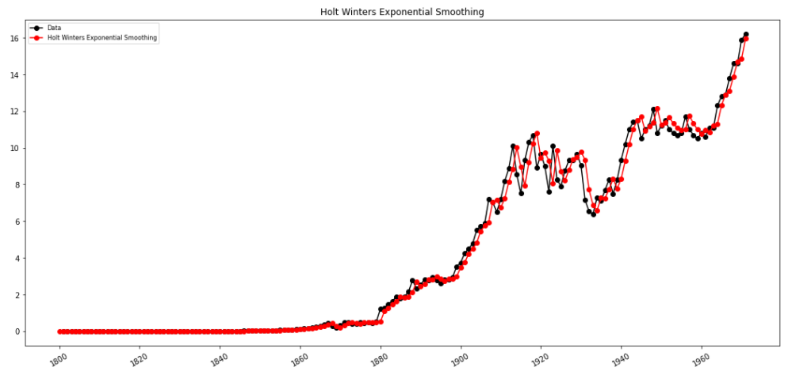
Holt’s Method for Exponential Smoothing
Expanding the Simple Exponential Smoothing method, the Holt’s method helps you to forecast time series data that has a trend

Slide 29
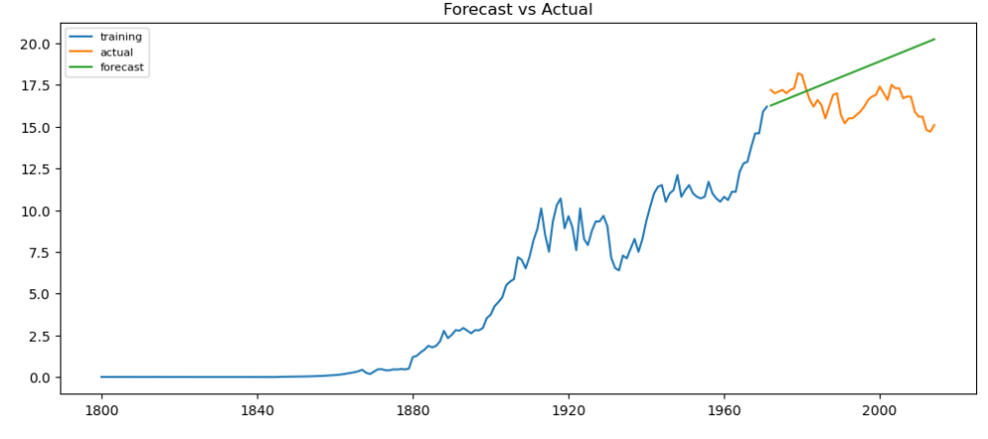
Holt’s Method for Exponential Smoothing
RMSE Value=2.4513
MAPE Value=0.704964

Slide 30
Holt-Winters’ Seasonal Method
The Holt-Winters model extends Holt to allow the forecasting of time series data that has both trend and seasonality, and this method includes this seasonality smoothing parameter.
There are two general types of seasonality: Additive and Multiplicative.
Additive: = Trend + Seasonal + Random Seasonal changes in the data stay roughly the same over time and don’t fluctuate in relation to the overall data.
Multiplicative= Trend * Seasonal * Random The seasonal variation changes in relation to the overall changes in the data. So, if the data is trending upward, the seasonal differences grow proportionally as well.

Slide 31
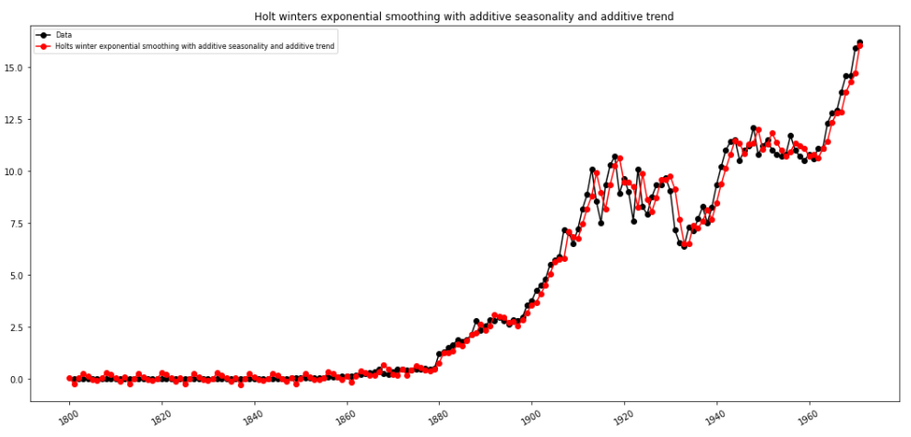
Holts winter exponential smoothing with additive seasonality and additive trend

Slide 32
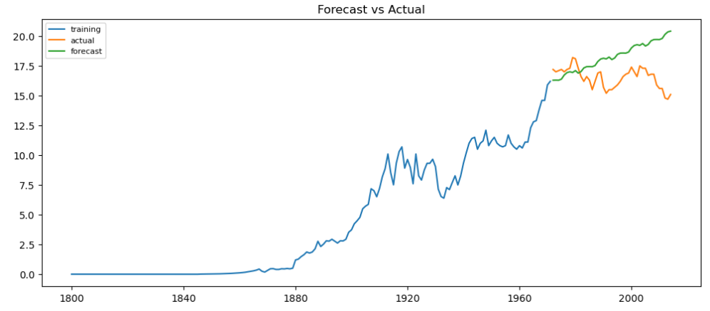
Holts winter exponential smoothing with additive seasonality and additive trend
RMSE Value=2.4574
MAPE Value=0.127488

Slide 33
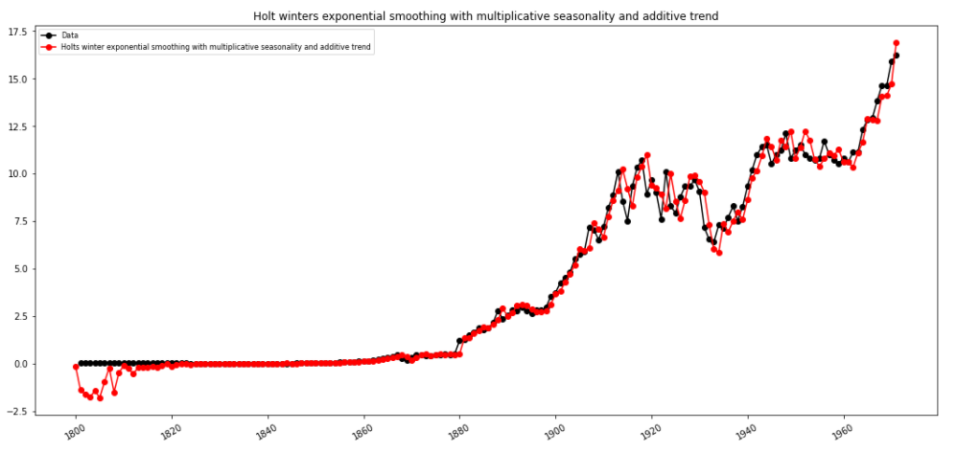
Holts winter exponential smoothing with multiplicative seasonality and additive trend

Slide 34
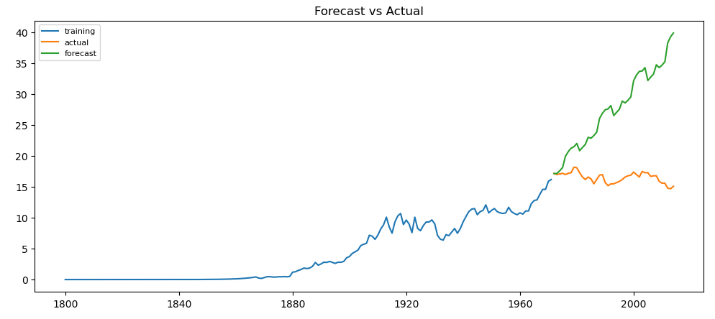
Holts winter exponential smoothing with multiplicative seasonality and additive trend
RMSE Value=12.9770
MAPE Value=0.687197

Slide 35
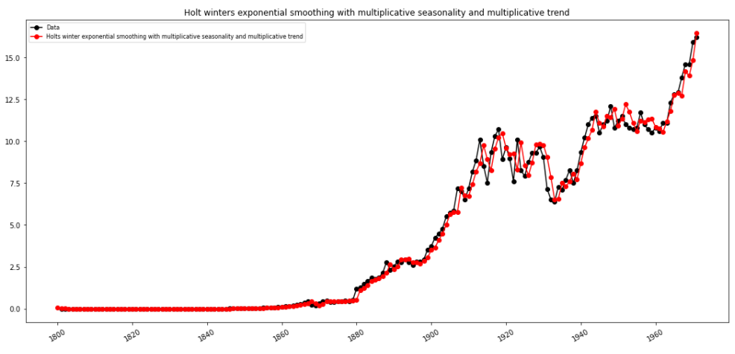
Holts winter exponential smoothing with multiplicative seasonality and multiplicative trend

Slide 36
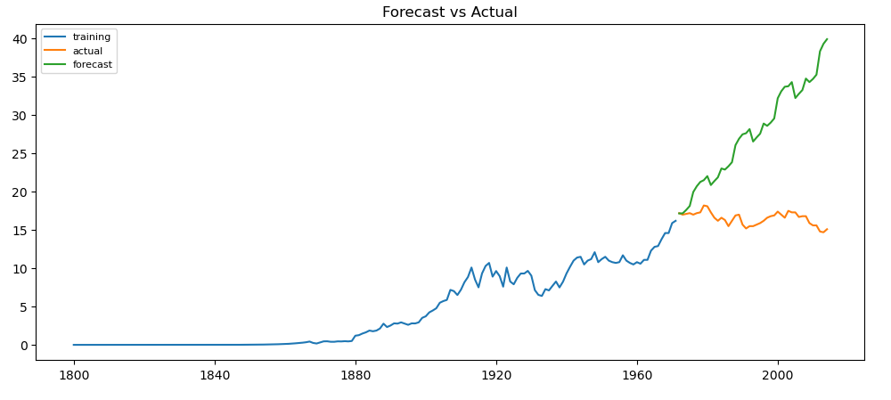
Holts winter exponential smoothing with multiplicative seasonality and multiplicative trend
RMSE Value= 12.977
MAPE Value= 0.6871

Slide 37
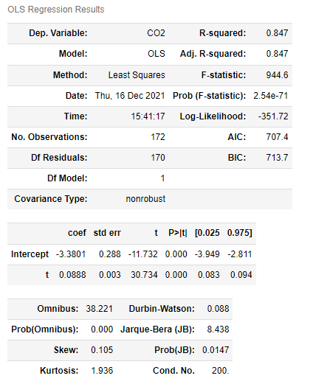
Linear Model

Slide 38
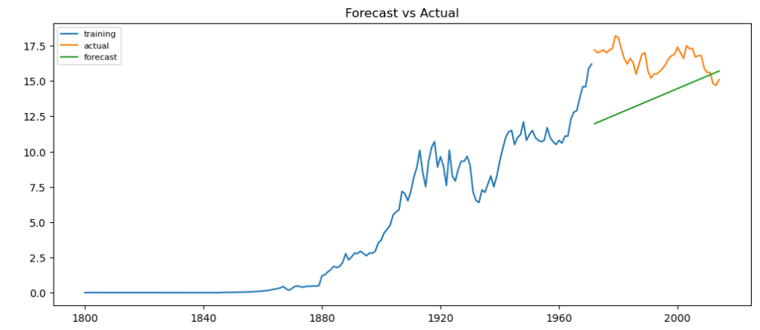
Linear Model
RMSE Value= 3.1445
MAPE Value= 0.164839

Slide 39
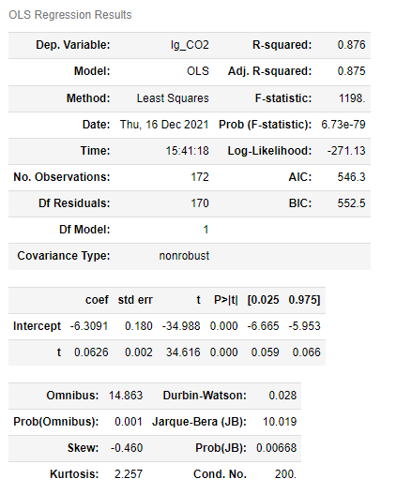
Exponential Model

Slide 40
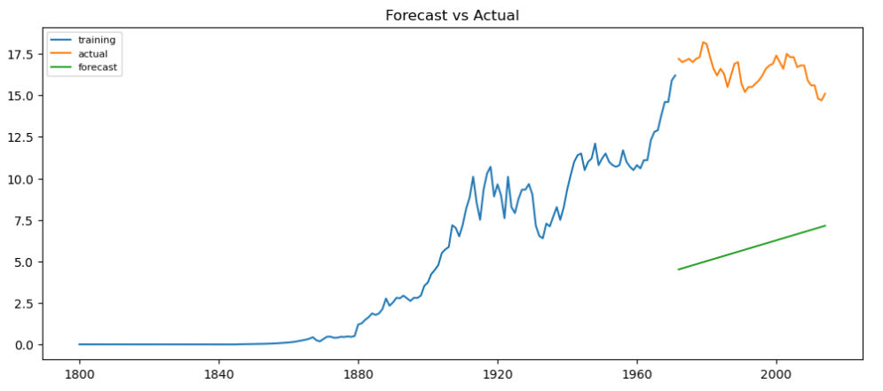
Exponential Model
RMSE Value= 550.3307
MAPE Value= 27.07095

Slide 41
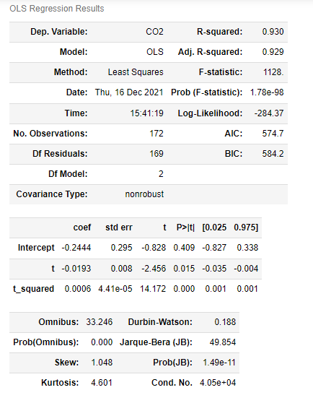
Quadratic Model

Slide 42
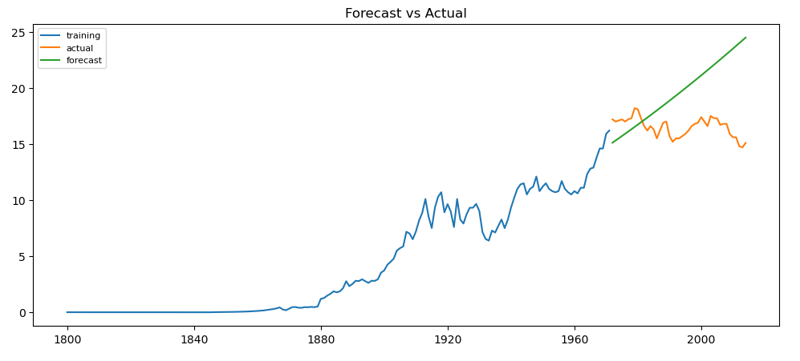
Quadratic Model
RMSE Value= 4.4951
MAPE Value= 0.231501

Slide 43
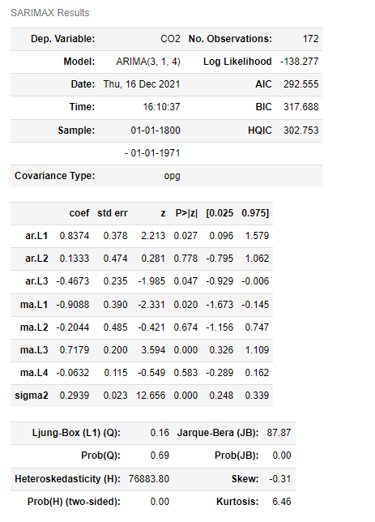
ARIMA Model (Non Stationary Data)
We have performed Grid search for hyper-parameters to find out optimal
order or (p, d ,q) for ARIMA model(Non -Stationary Data).
Best order found is (3,1,4) with least RMSE=0.494

Slide 44
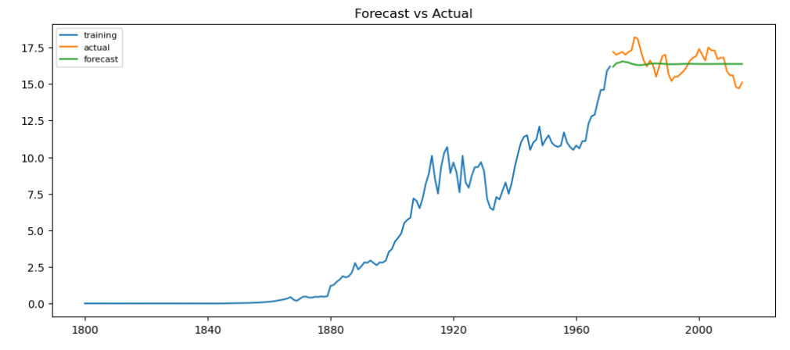
ARIMA Model (Non Stationary Data)
RMSE Value= 0.8483
MAPE Value= 0.0444

Slide 45
Forecasting Models(Stationary Data):
ARIMA Model
Auto Regressor Model
Moving Average Model

Slide 46
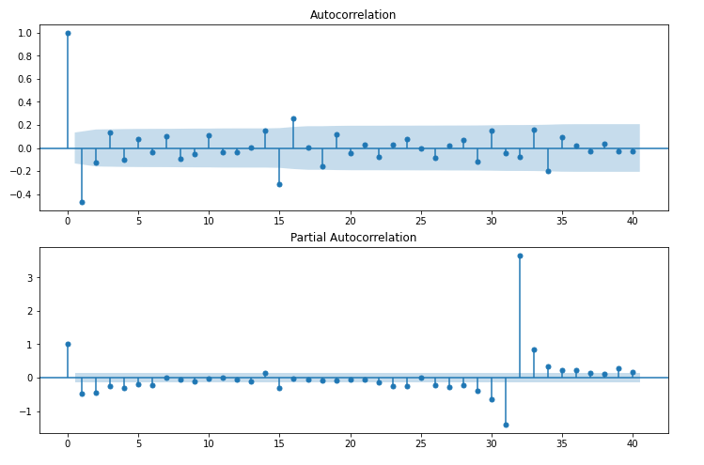
ACF Plot and PACF Plot(Stationary Data)
p – The lag value where the PACF chart crosses the upper confidence interval for the first time. In this case p=3.
q – The lag value where the ACF chart crosses the upper confidence interval for the first time. In this case q=2

Slide 47
ARIMA Model(Stationary Data )
ARIMA, short for ‘Auto Regressive Integrated Moving Average’ is actually a class of models that ‘explains’ a given time series based on its own past values, that is, its own lags and the lagged forecast errors, so that equation can be used to forecast future values.
We have performed Grid search for hyper-parameters to find out optimal
order or (p, d ,q) for ARIMA model(Stationary Data).

Slide 48
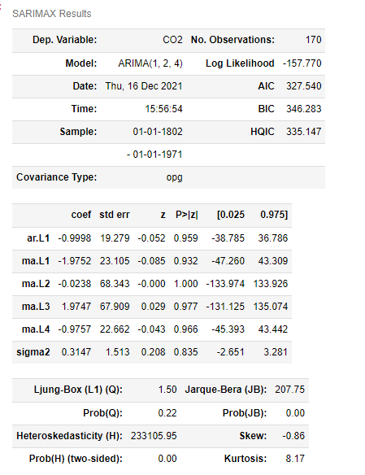
ARIMA Model(Stationary Data )
Best order found is (1,2,4) with least RMSE=0.535

Slide 49
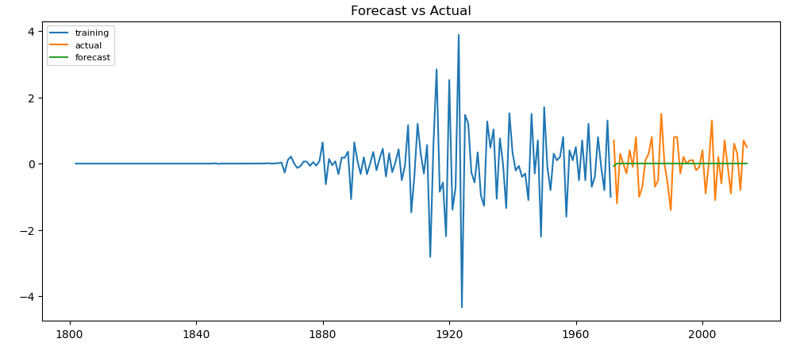
ARIMA Model
RMSE Value= 0.6709
MAPE Value= Inf

Slide 50
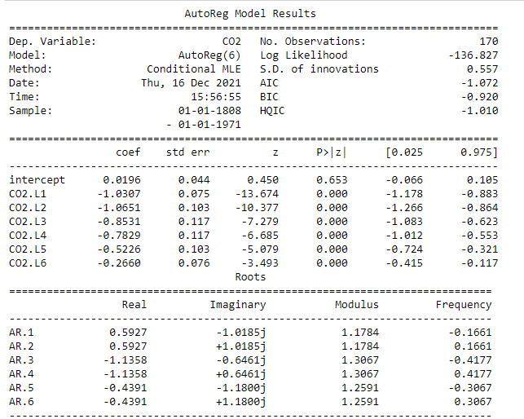
Auto Regressor (AR) model
An autoregressive (AR) model predicts future behavior based on past behavior. It’s used for forecasting when there is some correlation between values in a time series and the values that precede and succeed them.

Slide 51

Auto Regressor (AR) model
RMSE Value= 0.6742
MAPE Value= Inf

Slide 52
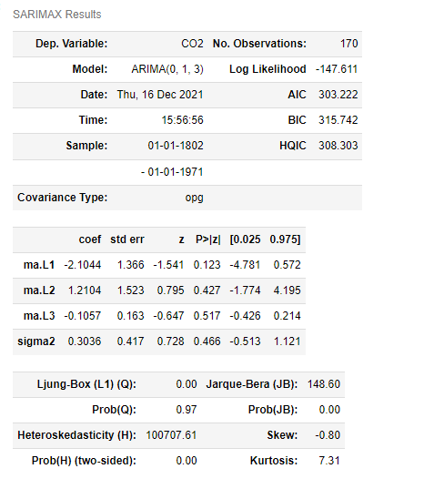
Moving Average Model
The moving average model is a time series model that accounts for very short-run autocorrelation. It basically states that the next observation is the mean of every past observation. The order of the moving average model, q, can usually be estimated by looking at the ACF plot of the time series.

Slide 53

Moving Average Model
RMSE Value=0.6710
MAPE Value= inf

Slide 54
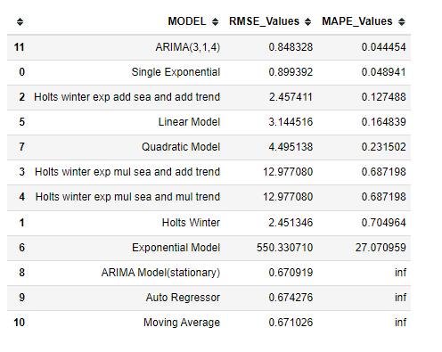
Comparison of Models on the basis of RMSE and MAPE
After comparing all RMSE and MAPE values of above models we have found that
ARIMA model (3,1,4) has least MAPE value = 0.0444 and RMSE value= 0.8483
we are considering ARIMA model (3,1,4) as our final model.

Slide 55
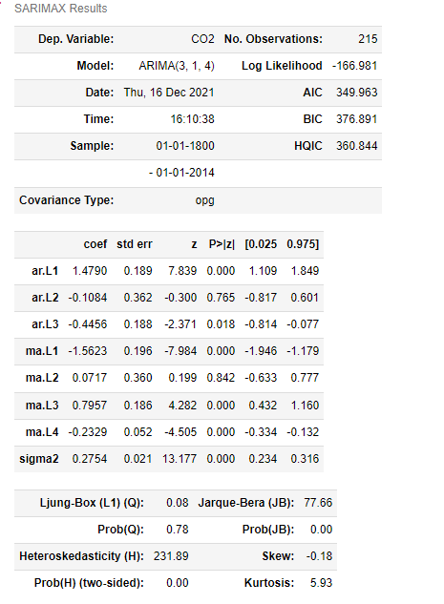
FINAL MODEL
We have selected ARIMA(3,1,4) as our final model because it has least MAPE value = 0.0444 and RMSE value= 0.8483.

Slide 56

FINAL ARIMA MODEL

Slide 57


Forecasting for next 5 years

Slide 58


Forecasting for next 10 years

Slide 59


Forecasting for next 20 years

Slide 60
DEPLOYMENT

Slide 61
DEPLOYMENT
We have deployed the final model using Streamlit
Steps to run python application:
Open Anaconda Prompt
Then run command : streamlit run Forecast.py
After opening of browser choose number of years you want to forecast
Forecasted results and graph will be displayed

Slide 62

Page after selecting About Data option(Given Data and Scatter Plot)

Slide 63

About Data Page:(Area Plot and Line Plot of the given data)

Slide 64

About Data Page:(Line Plot and Histogram of the given data)

Slide 65

Page After selecting Prediction option(Predicted CO2 Values of given data)

Slide 66

Page after selecting Forecast option (forecasting CO2 emission for next 20 years with line plot)

Slide 67

Page after selecting Forecast option (Area Plot and Histogram of forecasted data)

Slide 68
DEPLOYMENT WITH STREAMLIT CLOUD
Steps to run the application:
Streamlit Cloud launches apps directly from your GitHub repository, so our app code and dependencies need to be on GitHub before we try to deploy the app.
Add the required files to GitHub repository . we have added Forecast.py,CO2 Data.csv and requirements.txt into the GitHub repository.
Open streamlit.io website. Sign In into Streamlit account.
Link Streamlit account with GitHub Account.
To deploy an app into Streamlit, click "New app" from the upper right corner of your workspace, then fill in your repo, branch, and file path, and click "Deploy".
After opening of browser choose number of years you want to forecast
Forecasted results and graph will be displayed.
Link of the Deployment File:
https://share.streamlit.io/aishwaryachvn/project-forecast-co2-emission/main/Forecast.py

Slide 69

Deployment on Streamlit Cloud(forecasting of CO2 emission of next 28 years with Line Plot)

Slide 70

Streamlit Cloud(forecasting of CO2 emission of next 28 years with Area Plot and Histogram )

Slide 71
CONCLUSION
We have applied some Time Series Forecasting Models to the given CO2 dataset.
After applying some Forecasting models to the given dataset ,we have found that MODEL ARIMA gives good time series forecasting for CO2 emission.
Therefore, We have deployed ARIMA MODEL on Streamlit Cloud Platform.

Slide 72
Thank you!

